Slide 1
Safe Overtaking System (S.O.S.)
A Networked Camera Solution for Improved Road Safety
Sarvajanik College of Engineering & Technology
Team I’d = Team_3554
Team Leader :-
Members :-
Yashkumar Vaghani
Neel Kakadiya
Mentor :-
Nikunj Chauhan
Mr. Pravin Prajapati
Nischay Mistry
Trainer :-
Suryansh Swarnkar
Mr. Bassar M. Patel

Slide 2






AGENDA
WoW
Factors
Modelling
&
Technology
End
Users
Problem Statement & Project Overview
Topic 3
Conclusion
Topic 2
Topic 4
Topic 1
Topic 5
Agenda

Slide 3

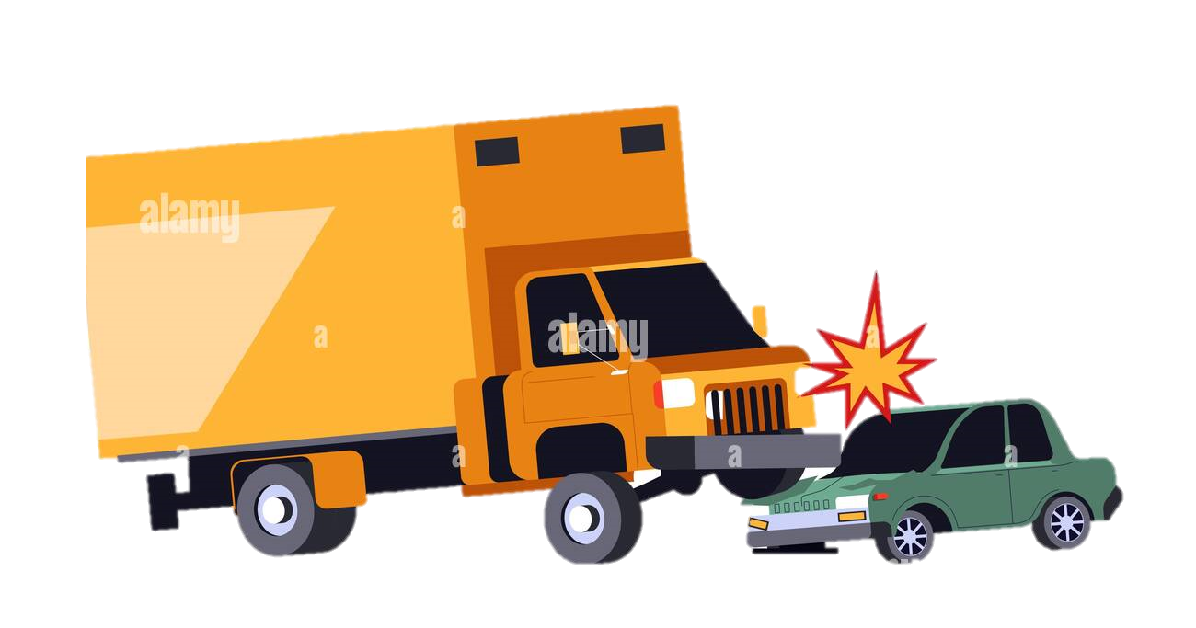
PROBLEM STATEMENT
The most of the severe highway
road accident occurs while large
vehicle is blocking frontal view
information during overtaking
by another vehicle.

Slide 4




PROJECT OVERVIEW
Use of Built In Camera
AM Radio To Connect
Wi-Fi Hotspot to Share video

Slide 5







Who Are The Users ?
Automobile Companies
Businesses of Transport vehicles
Car/Bus/Truck Users.

Slide 6
THE WOW FACTOR IN OUR SOLUTION
Innovative Solution
- Wireless Transmission
- Auto Communication
- Upgradable
- AM radio communication
- Wide accessibility
- Globally Adaptable
- Can be Implemented AI technology
- Competitive advantage
User-Friendly System
Scalable Solution

Slide 7


Modelling
AM Radio Communication
Radio Transmitter
Radio
Receiver
Receiving
Data
Data to be
Transmitted
Radio Waves

Slide 8



AM Radio Communication
Carrier Signal (1 MHz)
Signal Generated by Transmitter
with Amplitude Modulation
Data to be Transmitted (Low Freq)
Radio Receiver
Radio Transmitter

Slide 9
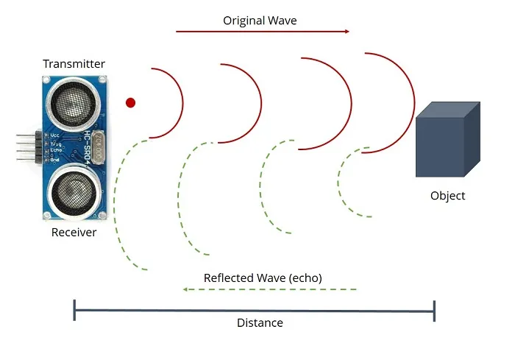
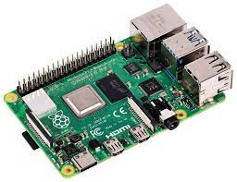



Used Technologies
Ultrasonic sensor
Raspberry Pi 4 Model B

Slide 10
Used Technologies
AM Radio Communication
Radio Transmitter
Radio Receiver

Slide 11

Used Technologies
Python Programming
(Libraries)
OpenCV (Graphical Presentation)
Socket (Video Transmission)

Slide 12


RESULTS
Real Time Video Footage
Use of Wi-Fi Hotspot to transmit data
Improved Safety
Scalability
Technology: The system uses modern technology, such as Wi-Fi hotspot communication and AM radio communication, to transmit live video from a built-in camera in the leading vehicle to the rear vehicle display, making it an innovative and advanced solution.
Improved safety: By providing drivers with real-time information about road conditions and potential hazards, the system has the potential to significantly reduce the number of highway accidents and improve overall road safety.
Scalability: The system can be implemented in vehicle of all sizes, making it a flexible and adaptable solution that can be tailored to meet the specific requirements of different businesses.
Real-time video footage: The system provides real-time video footage of the road ahead to the rear vehicle, allowing drivers to see potential hazards and obstacles in real-time.
GitHub Link :- https://github.com/suryansh5125/Team_3554-CodeUnnati-Innovation-Marathon

Slide 13

CONCLUSION
Easy implementation
Use of AM radio makes it user friendly
Helps to Reduce Highway Road Accident

Slide 14





MEET OUR TEAM
Suryansh
Swarnkar
Yash Vaghani
Nischay Mistry
Nikunj Chauhan
Neel Kakadiya

Slide 15
